Slide 1

INTRODUCTION
May 2018
Bangalore
INTRODUCTION
May 2018
Bangalore
May 2018
Bangalore

Slide 2
Business Analytics
Business Problem
Data Preprocessing & Understanding
Mathematical
/Statistical
Solution
Information Deployment
BUSINESS ANALYTICS

Slide 3
“
“
Data matters. “Not everything that can be counted counts, and not everything that counts can be counted,” attributed to Albert Einstein, explains the purpose of business analytics perfectly.
WHY BUSINESS ANALYTICS
Why
Business
Analytics
Understanding
Business Requirement
Review Business
Performance
Competitor
Analysis
Informed Decision Making

Slide 4
WHAT IS BUSINESS ANALYTICS
Use of data and information (both structured, semi-structured and unstructured) along with human intelligence
➢ In combination with information technology, software's, frameworks and tools
➢ Triggering informed business decision making, so that business value can be optimized
➢ A very structured thinking process
➢ Involves a lot brainstorming sessions with all the stake holders
➢ Data can be in any form, that has no defined source
………..

Slide 5
APPLICATION/USE CASES
Business
Analytics
Stock
MarketDigital
Marketing
Customer
Relationship
Entertainment
Promotions
HealthCare
Insurance
Sports
Digital
Marketing
………..

Slide 6
Business
Analytics
Operational Efficiency
Smart Decision
Making
Clear Picture about Data through Data visualisation
Driving Profitability
Achieve Business Targets in a Time Bound Manner
Formulate right
strategies
RELEVANCE OF BA
………..

Slide 7
STAGES OF BA
Descriptive
Analytics
Diagnostic
Analytics
Cognitive
Analytics
Predictive
Analytics
Prescriptive
Analytics
………..

Slide 8
Descriptive Analytics
➢ A method of finding the historical trends
➢ Helps in reflecting the as is scenario
➢ Shows what has happened in past
➢ Shows how the business has performed in past
➢ Can be delivered using business intelligence tools
➢ Shows basic statistics about any business metrics
➢ Easily interprets Business metrics
➢ At this stage what happened will be analyzed
………..

Slide 9
Diagnostic Analytics
➢ Key factors will be analyzed in this stage
➢ Analyses root cause of the problems
➢ Identifies different stages of the problem
➢ Analyzes why the problem happened
➢ Details all the axis of the problem
➢ Involves a lot of reporting
➢ Various different reports indicate just another perspective
➢ Involves some degree of correlation and association
………..

Slide 10
Prescriptive Analytics
➢ Stage prescribes recommendations
➢ If a certain business metric predicted to go down, what recommended action is required.
➢ Helps a business in forming strategies
➢ Helps in preparing the plan B if the things are not going in right direction
➢ A reactive analysis, as something happens what action required and if not what alternate action required.
➢ A set actions always triggered based on predictions
………..

Slide 11
Predictive Analytics
➢ This step shows what is likely to happen?
➢ Can we predict the future events, given the historical data?
➢ How well we can predict given the features?
➢ Depends on the previous stage, where we are creating the factors that affect the problem statement
➢ Involves a lot of statistical model building
➢ Statistical model also requires a sense of probability
➢ Probability distribution and future prediction is related
………..

Slide 12
Cognitive Analytics
➢ This is the artificial intelligence and machine learning layer
➢ If we know the prediction and recommended action to be taken:
• Can any machine take decisions?
• Can we do any what-if analysis?
• Can machines decide what recommendation to be given?
➢ The cognitive function, based on reasoning and logic
➢ Involves machine learning models
➢ Involves a set of rules
………..

Slide 13
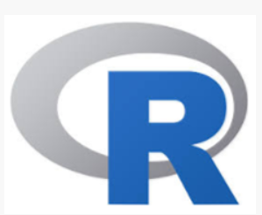







Different tools Used for Data Analysis

Slide 14
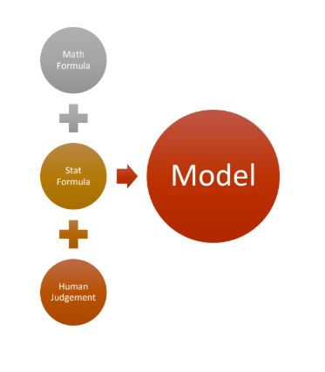
What is a Model?

Slide 15
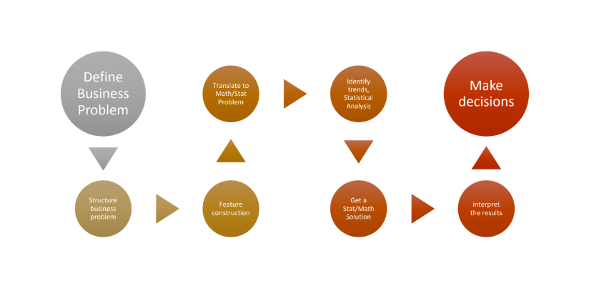
Steps in Model Building

Slide 16
Computer Science
Domain
Expertise
Mathematics
Data Processing
Statistics
DATA
SCIENCE
Machine
Learning
………..
Notes:
Data science is a multidisciplinary blend of data inference, algorithm development, and technology in order to solve analytically complex problems.
Analytical Problem‐Solving - Know how to approach high-level challenges with a clear eye on what is important; Employ
the right approach and methodology to make the maximum use of time and human resources.
Industry Knowledge-Understand how the industry you work in functions and how data is collected, analyzed and
utilized to make decisions

Slide 17
What is Data Science
➢ The computer science contributes in making newer programming languages, newer databases, smarter implementation
of various newer tools, and integration of applications for smooth data operations.
➢ As a Data Scientist, a person should have idea about computer science fundamentals and basic programming knowledge
in any one language.
➢ If someone is very good at Mathematics and Statistics, understands computer vision, then computers can be trained to
perform certain task automatically by learning new patterns from data.
➢ Machine Learning is that branch of data science, where the system gets better as it learns new patterns over a period of
time, specific to a particular task.
➢ As a Data Scientist a person should be thinking towards large scale machine learning.
………..

Slide 18

A day as a Data Scientist
➢ A Data Scientist tries to understand the business problem,
availability of data relating to a business problem and
additional data that they may need to build the solution
➢ A Data Scientist formulates hypothesis from the data
relating to the business problem
➢ A Data Scientist runs various experiments with data
by applying mathematical and statistical techniques
for data discovery and
pattern recognition
➢ Finally, a Data Scientist conveys relevant business stories
to the stake holders about their business problem
and possible recommendations.
………..

Slide 19
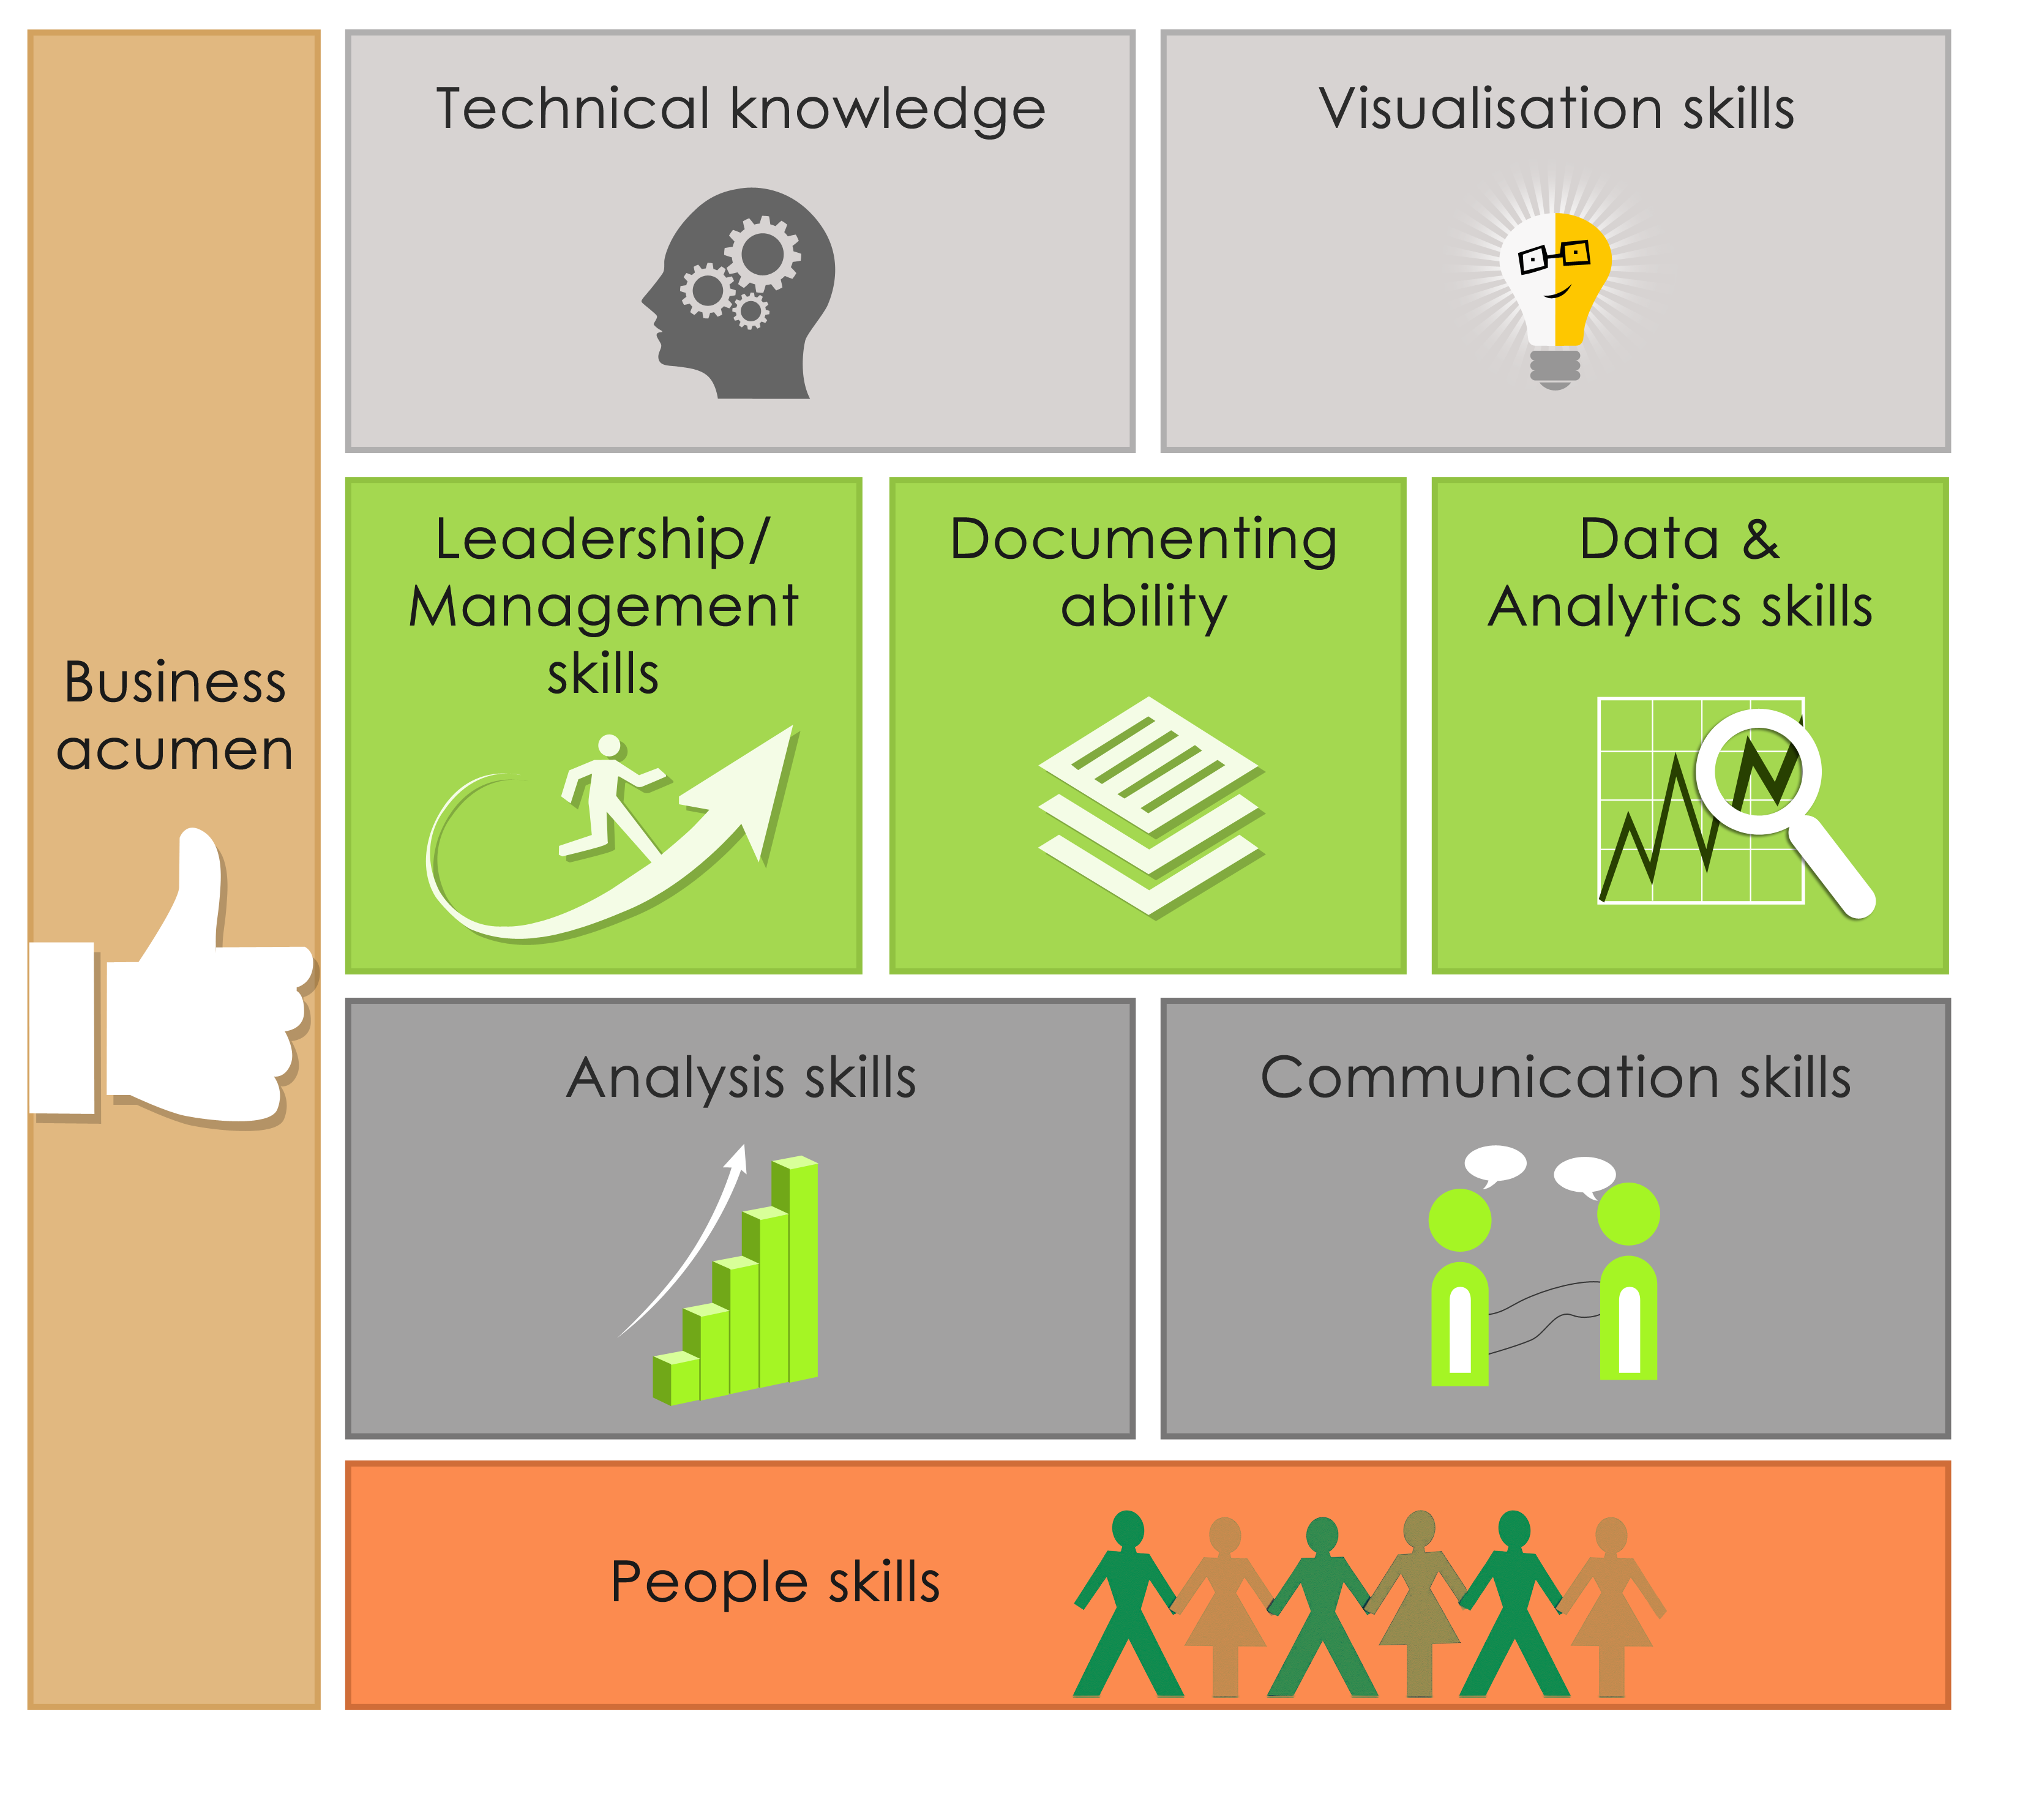
Pre-requisite of a Data Scientist
………..

Slide 20
What is Machine Learning
A computer program is said to learn from experience E with respect
to some class of tasks T and performance measure P, if its performance at tasks in
T, as measured by P, improves with experience E.
-Tom Mitchell
………..

Slide 21
Some of Analytics companies in Bangalore using R and recruiting engineers with R skills
AbsolutData Analytics
Fractal Analytics
Loylty Rewardz
Flutura
Vizury
Mu Sigma
AXA,
Goldman Sachs,
Morgan Stanley,
American Express,
Deloitte,
Metro(Cash & Carry)

